Slide 1
Devo Manc
Barry Kinshuck
GDPC Greater Manchester

Slide 2
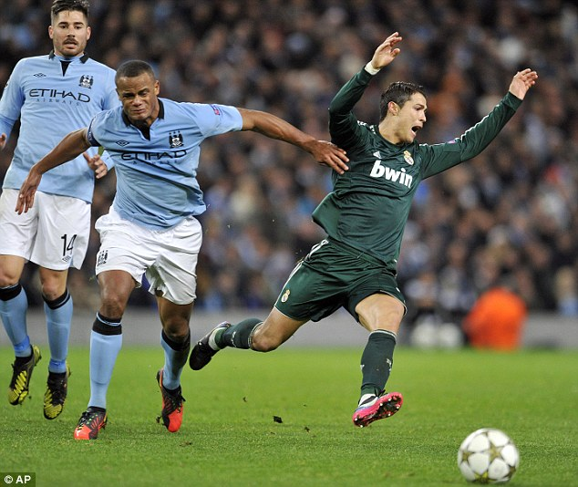
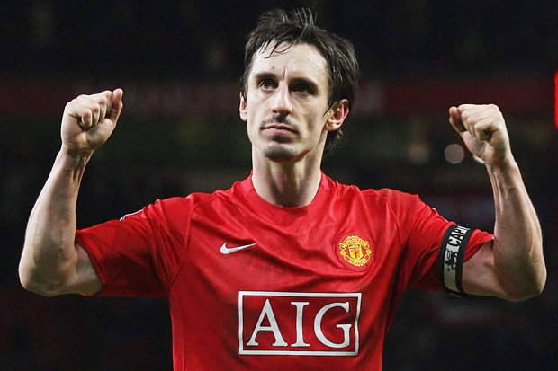

Slide 3
What is Devo Manc
Greater Manchester and NHS England recently announced ground breaking plans around the future of health and social care with a signed memorandum agreeing to bring together health and social care budgets with a combined sum of £6billion.
Simon Stevens, NHS England CEO, welcomed DevoManc as ‘the greatest act of devolution in the history of the NHS’.

Slide 4
This trailblazing move, on Friday 27 February 2015, saw:
NHS England
12 NHS Clinical Commissioning Groups
15 NHS providers
10 local authorities
All agreed a framework for health and social care with plans for joint decision-making on integrated care to support physical, mental and social wellbeing.

Slide 5
The Memorandum of Understanding
Approved and countersigned by the Chancellor and the Health Secretary and puts local people in the driving seat for deciding on health and care services that suit Greater Manchester.
The Queens Speech at the recent Opening of Parliament made a number of pledges around health and social care, strengthening what we are already putting into practice.
What we are doing in GM will pave the way for others.
Ian Williamson Chief Officer GM CCG
Notes:
What is the memorandum

Slide 6
The Vision
To ensure the greatest and fastest possible improvement to the health and wellbeing of the 2.8 million citizens of Greater Manchester

Slide 7
The Objectives
Improve the health and wellbeing of all of the residents of Greater Manchester from birth to the elderly.
Recognising that this can only be achieved with a focus on the prevention of ill health and the promotion of wellbeing.
The need to move from having some of the worst health outcomes in the country to having some of the best.
Close the health inequalities gap within GM and between GM and the rest of the UK faster

Slide 8
The Benefits
Impact, more quickly, on the health, wealth and wellbeing of the GM population.
Co-ordinate services to tackle some of the major health, housing, work and other challenges - supporting physical, mental and social wellbeing
Making best use of existing budgets especially reducing pressure on A&E and avoiding hospital admissions.
Integrated care in Greater Manchester will focus more on preventative work in the community.
The rest of the country will monitor what happens in Greater Manchester.
Notes:
For example, people with long-term conditions like asthma or heart conditions will be treated by specialists in the community as much as possible – only going to hospital when necessary.
For example, people with long-term conditions like asthma or heart conditions will be treated by specialists in the community as much as possible – only going to hospital when necessary.

Slide 9
Early Implementation Priorities
Seven day access to primary care
Public Health programme
Academic Health Science System (AHSS)
Healthier Together Programme
Dementia Pilot
Mental Health and Work
Workforce policy alignment
Notes:
Seven day access to primary care – lead Rob Bellingham, Director of Commissioning for the Greater Manchester Area Team of NHS England and Public Health campaign – lead Steve Pleasant, Chief Executive/ Lead Chief for Health, Tameside MBC / AGMA health and social care devolution team This builds on the successful track record of increaing access to primary care through Wave 1 of the Prime Minister’s Challenge Fund (PMCF) in Bury, the GM Primary Care Demonstrator programme and the successful Wave 2 PCMF bids in the City of Manchester and Wigan. The greatest and fastest possible health improvement will not just come from integration but also from prevention. This will develop a programme engaging the whole system to deliver increased participation in physical activity and sport. It will be a partnership between Public Health England, GMCA, GM CCGs and other bodies such as GreaterSport, Transport for Greater Manchester and leisure providers, amongst others. Academic Health Science System (AHSS) – lead Sir Michael Deegan, Chief Executive, Central Manchester University Hospitals NHS Foundation Trust This will align the work of Manchester Academic Health Science Centre (MAHSC), Greater Manchester Academic Health Science Network (GMAHSN) and Local Clinical Research Network (LCRN) into an integrated system that will lead the country.
Healthier Together decision – lead Ian Williamson, Chief Officer of Central Manchester CCG All Greater Manchester CCGs will reach a decision on the recommended configuration of the Healthier Together single service model across urgent and emergency care, acute medicine and general surgery.
Dementia Pilot – lead Sir David Dalton, Chief Executive, Salford Royal NHS Foundation Trust Salford will pilot a a programme for people living with dementia, supporting the development of integrated services to improve the quality of care they receive. There will be the opportunity to use technology in MediaCity and digital advances to support patients to remain at home and be discharged safely from hospital when they do need treatment. Mental Health and Work – lead Warren Heppolette, Strategic Director Health and Social Care Reform This project will aim to reach agreement on a new more intensive and integrated delivery model for supporting unemployed people who have a mental health-related barrier to work. The role health services play in helping people find employment and keep it will be examined as a small pilot of 5,000 growing to 50,000. Workforce policy alignment – lead Darren Banks, Director of Strategy, Central Manchester University Hospitals, NHS Foundation Trust This piece of work will aim to reach agreement between providers on: common standards on pre-employment checks, statutory and mandatory training and common rates for specific targeted locum and agency staff.

Slide 10
The Programme
Greater Manchester Health and Social Care Devolution Programme Board
GM Health and Social Care Devolution Transition Management Team
Strategic Plan (Clinical & Financial Sustainability)
Establishing Leadership, Governance & Accountability
Devolving Responsibilities and Resources
Partnerships, Engagement and Communications
Early Implementation Projects
Strategic Direction
(Alex Heritage)
Programme Board and Infrastructure
Resources and Finance
Communications
7 day access to general practice (Rob Bellingham)
Locality and Sector Plans
(Warren Heppolette)
Strategic Partnership Board
Primary Care Transfer
Public engagement
Public health programme (Steven Pleasant)
GM Transformation Proposals
Joint Commissioning Board
Specialised Services Transfer
Change movement
Academic Health Science System (Sir Mike Deegan)
Healthier Together decision (Leila Williams)
Financial Plan and Enablers
(Carol Culley / Joanne Newton)
Provider Forum
Prevention and Public Health
Dementia pilot (Sir David Dalton)
Legislative and Accountability framework
Workforce Training and Development
Mental Health and Work (Warren Heppolette)
Workforce policy alignment (Darren Banks)
10
Notes:
Early Implementation Priorities In early 2015 people from across the NHS and public sector in GM identified a ‘long list’ of areas they felt were both important and had the potential to make a difference quickly. All were then scored, based on potential impact, how practical they would be to implement, value for money and whether they cover different areas as well as health, for example: wealth creation, employment and social care.

Slide 11
Timeline to Devolution
Spring 2015
Summer 2015
Autumn 2015
Winter 2015
Spring 2016
Summer 2016
Autumn 2016
Winter 2016
Spring 2017
DECEMBER: In preparation for devolution, GM and NHSE will have approved the details on the funds to be devolved and supporting governance, and local authorities and
CCGs will have formally agreed the integrated health and social care arrangements.
DECEMBER: Production of the final agreed GM Strategic Sustainability Plan and individual Locality Plans ready for the start of the 2016/17 financial year
APRIL: Process
for establishment
Of Shadow
Governance
Arrangements
Agreed and
initiated
APRIL: Full devolution of agreed budgets, with the preferred governance arrangements and underpinning GM and locality S75 agreements in place.
MAY-DECEMBER:
Announcement of
Early implementation Priorities
OCTOBER: Shadow arrangements in place and start for budgets, governance and accountability
AUGUST: Production of an Outline Plan to support the CSR process which will Include a specific investment fund proposal to further support primary and community care and will be the first stage of the development of the full Strategic Plan.

Slide 12
The approach will help realise the vision set out in the NHS’s Five Year Forward View.
This historic agreement does not require any reorganisation of the NHS or its principles.
Decisions about Greater Manchester will be taken in Greater Manchester
Notes:
Not elected Mayor of Greater Manchester

Slide 13
Commitment
I want to make absolutely clear that this is not a town hall takeover of Greater Manchester’s NHS budget.
Lord Peter Smith, Chair of Greater Manchester Combined Authority

Slide 14
What does this mean for Dentistry
Budgets for pharmacy, dental and ophthalmic commissioning functions cannot currently be pooled with local authorities.
Are we to see further delegation of such functions to CCGs from NHS England as an extension of primary medical co-commissioning, and is this capable of being agreed within a short timeframe, or will Greater Manchester CCGs be the “guinea pigs” for this?
Could dental contracts be held locally?

Slide 15
Opportunities in Dentistry
Implement innovative approaches to tackle long standing problems with poor oral health.
To reduce the inequalities in access and improve quality of the dental service.
The clinical networks and commissioning partnerships are strong in dentistry in GM and have a proven track record of innovation and delivery within the limitations and constraints of the current primary care contract.

Slide 16
Local Dental Networks Aims
The aim of the LDNs was to work with the area teams to implement new national frameworks that promote innovation and best practice.
Share expertise to get the best ‘local fit’. Clinicians within LDNs.
Work with local partners, including patients, established wider dental networks and specialist groups to implement pathways to meet local needs.

Slide 17
LDN GM
LDN initiative Baby Teeth Do matter with the ultimate aim to reduce the number of under 5 admissions into hospital for GA extractions
LDN initiative Gums do matter
LDN work on reducing orthodontic waiting lists by working with practices has resulted in a significant reduction in waiting times for patients.
Without any further funding!

Slide 18
What’s in Place Now
A strategic clinical and commissioning GM dental team is ready to exploit the flexibility devolution offers.
They are ready to support the objectives and principles of devolution for the benefit of GM citizens and patients.
This group understands the population needs, evidence of what will work, and the pace and scale needed in GM to make a real difference.
They would lead the dental, health and social care communities to understand what actions are necessary to improve oral health.
Bring about unrivalled benefits for GM citizens that would improve oral health and lead to responsive and effective dental services.
Notes:
LDC involvement

Slide 19
Dentistry and Devo Manc
Dentistry has yet to be mentioned
We need to be invited to join in the strategic planning for Devolution in Manchester as the leaders for oral health and dentistry.

Slide 20
Dentistry and oral health could deliver quick and measureable wins
Evaluate two key work areas to tackle noted problems in Greater Manchester.
High levels of decay among 0 to 5 year olds with high numbers of children having extractions of decayed teeth in hospital.
The benefits could be realised within two years and oral health improvements made. The success of the Childsmile scheme by the devolved administration of Scotland could be used to demonstrate the benefits that could be achieved.
Over a fifth of GM adults have urgent dental conditions and 31% have experienced dental pain in a 12 month period.
Incentivise practices and reduce the impact on A&E and primary medical care and ensure that dental problems are prevented and addressed.
Notes:
P

Slide 21
Investment?
What investment is required to make the required changes?
Use the resources we have more effectively.
Imaginatively stimulate practices and specialist services to work more collaboratively.
Demonstrate the return on investment and the health improvement benefits to GM.

Slide 22
Wigan
LDC are already working with the local council health teams.
Making every contact count
Greater use of the Dental Teams and more job satisfaction.
No more money!

Slide 23
Notes:
Wigan Healthy Living Dentistry programme that links in with Health improvement teams at Wigan Council – All part of making every contact count.

Slide 25
The Questions
Many important questions remain unanswered:
What is the role of clinical commissioning groups in the proposed arrangements?
Will this be a further layer of decision-making being superimposed on an already complex system?
The implications for providers are equally unclear, particularly around their relationship with national regulators.
What ‘national’ means in a devolved health and care system and the areas in which local variations in services and standards are not permitted.

Slide 26
How will the inevitable overspending of NHS budgets be handled? Could the local authorities switch funding from the NHS to other services?
Will the blame for unpopular decisions be shifted from Whitehall to town hall in the absence of sustainable funding agreements?
Is Devo Manc plan a blitzkrieg attack to fast- track the reconfiguration of the NHS into new business models ready for private company take over? [Greater Manchester Association of Trades Union Councils ]

Slide 27
The Final Word
We are definitely looking at the opportunity to include dentistry within the scope of the Devolution work, although as yet, no decisions have been made in this regard.
Director of Commissioning
(Greater Manchester)

