Slide 1
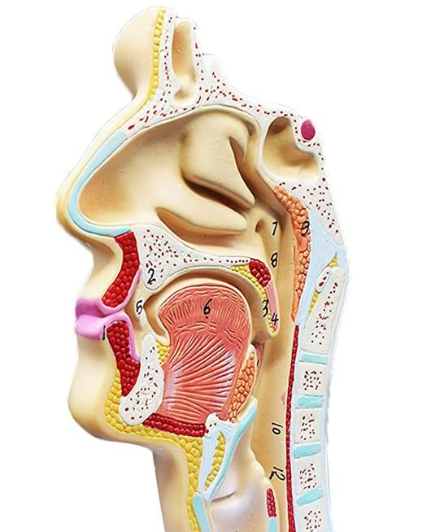
OPPORTINITY FOR CHANGE
Developing Dental Care Pathways for Access Patients

Slide 2
What We Want To Achieve
Timely access to prevention focused NHS dental care
Improve population health and wellbeing
Sustained and whole system change underpinned by contract reform
Oral health intelligence and evidence driving improvement
Teams that are trained, supported and delivering
A simpler way to access dental care services
A network of strong, joined up services to manage and co-ordinate care
Reduced waiting times to increase patient flow and access
Reduced patient presentation in secondary care

Slide 3
PRINCIPLES AND GUIDANCE
Referral Management Centre (RMC)
Triage contact with patient needs to be more comprehensive
Robust triage template and further training for members of the team:
Training to be provided by the DPA team/Primary Care team
Monitoring via 3-montly audit of the RMC data done by Primary Care team
Operates 7/7 (out of hours)

Slide 4
PRINCIPLES AND GUIDANCE
Referral Management Centre (RMC)
Triage template (examples questions):
However you answer this question, you will have an appointment to address your urgent need/ emergency care
“Would you like to see a dentist and just have a one off appointment to deal with the urgent need/emergency care?”
or
“Would you like to see a dentist to address the urgent need/emergency care and also to see you for a one course of treatment to treat other problems and stabilise your dental health?”

Slide 5
PRINCIPLES AND GUIDANCE
Regular care is not readily available as GDS is prioritising:
backlog of outstanding treatments
urgent known dental needs
These pathways do not include <18 patients – new specific pathway to be developed
The contents of the slides 6, 7 and 8 are a starting position to initiate a discussion; they are not intended to be the final outcome or be comprehensive.

Slide 6
IN HOURS ACCESS PATIENTS PATHWAY (DRAFT)
Patient calls 111 in pain gets directed to RMC
Patient payment of £14.70
IHA slot of 30 minutes for urgent treatment
Urgent Acorn and topical fluoride application not mandatory
Practice responsible for dry socket or pain (for example) on treated area for 7/7
Patient calls in pain > 7 days of appointment for urgent care
Patient calls back in pain ≤ 7 days of appointment for urgent care
Practice phones RMC and uses another IHA slot for pain management

Slide 7
STABILISATION PATHWAY (DRAFT)
Patient calls 111 in pain gets directed to RMC
Patient payment between £47 and £203
Patient is sent to a Dental Practice
Exam + Radiographs + urgent care (40 minutes slot)
Acorn + topical fluoride mandatory
Practice contacts RMC when patient is discharged with discharge data
Patient in pain > 2 months of finishing course of treatment (COT)
Patient in pain ≤ 2 months of finishing COT
Problem to be dealt by practice as per duty of care

Slide 8
Further Considerations
How does this fit with the caries and periodontal pathways? How does the engagement of the patient get assessed with only one COT?
How does it fit with contract reform and changes due in April 2022?
What happens to patients that fail to complete COT in the Stabilisation Pathway? Do they get redirected to IHA? Do they go back to Stabilisation Pathway? Same practice or different practice?
What is the pathway for patients with known dental needs, no pain and no dentist (for example: lost filling, broken tooth, crown out)?
What is the pathway for patients without known dental needs, no pain and no dentist (want a check-up)?
RMC not identifying the patients as the same person – example misspelling names or incorrect DOB
What happens to the patient in pain after 2 months of finishing COT?
Do these pathways also apply to <18 patients?
What is stabilisation?

