Slide 1
Morgannwg LDC
Summary of Points at BDA Open Meeting
4th July 2022

Slide 4
Attendance at Meeting
Total 75
Contract Reform (approx. 80%) 60
UDA (approx. 20%) 15

Slide 5
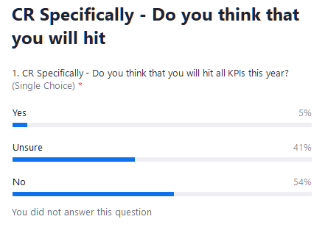

Slide 6
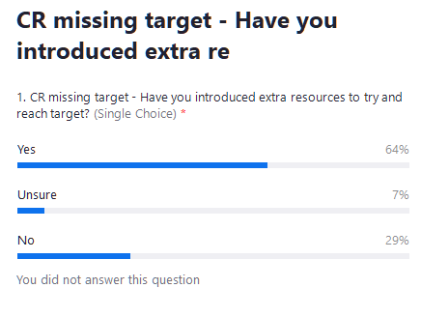

Slide 7
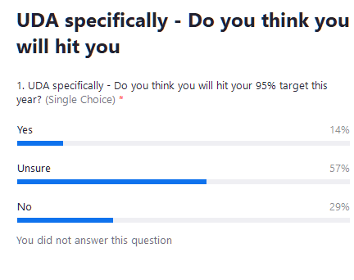

Slide 8
