Slide 1
Morgannwg LDC
Some Workforce Survey Figures to Date

Slide 2
Responses to Date 15th September 2022
Total Practices SBUHB 66
Total Responses to Date 35
Percentage Response to Date 53%

Slide 3
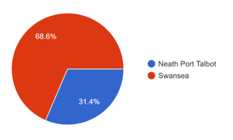
Responses to Date by Locality 15th September 2022
Neath Port Talbot 11
Swansea 24
Total 35

Slide 4
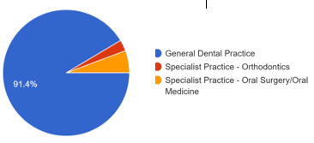
Responses to Date – Practice Type 15th September 2022
General Practice 32
Specialist Ortho 1
Specialist OS / OM 2

Slide 5
Responses to Date 15th September 2022
Total Practices SBUHB 66
Total Responses to Date 35
Percentage Response to Date 53%

Slide 6
Working Dentists 15th September 2022
Number in GDS Practices 106
Number of Whole Sessions Worked 620
WTE doing GDS Work 39.3

Slide 7
Working Dentists 15th September 2022
Number in 35 GDS Practices 106
WTE doing NHS Work 39.3
WTE doing Private Work 22.8
WTE doing General Dental Work 62.1

Slide 8
Foundation Dentists Last 5 Years 15th September 2022
Number of GDS Training Practices 11
Number of FDs Trained 45
Number of FDs Remained at Practice then left 1 0.02%
Number of FDs Remained at Practice 4 0.08%

Slide 9
Foundation Dentists Last 5 Years 15th September 2022
Number of GDS Training Practices 11
Number of FDs Trained 45
Number of FDs still in Wales 23 51.1%
Number of FDs stayed then left Wales 6 0.13%

Slide 10
Dental Nurses 15th September 2022
Number in 35 SBUHB Practices 230
Number of Whole Sessions Worked 1282
WTE Working 128.2

Slide 11
Dental Nurses 15th September 2022
Number in SBUHB Practices 230
Number of Trainee Dental Nurses 58
WTE Working 128.2

Slide 12
Dental Nurses 15th September 2022
Number in SBUHB Practices 230
Number Trained to Perform Extra Duties 76 33.00%
Practices with Current Vacancies for DNs 14 40.00%
Number of Unfilled Vacancies 17

