Slide 1
Morgannwg LDC
Workforce Survey Figures
September 2022

Slide 2
Responses
Total Practices SBUHB 60
Total Responses 50
Percentage Response 83%

Slide 3
Responses by Locality
Neath Port Talbot 13
Swansea 37
Total 50

Slide 4
Practice Type
General Practice 47
Specialist Ortho 1
Specialist OS / OM 2

Slide 5
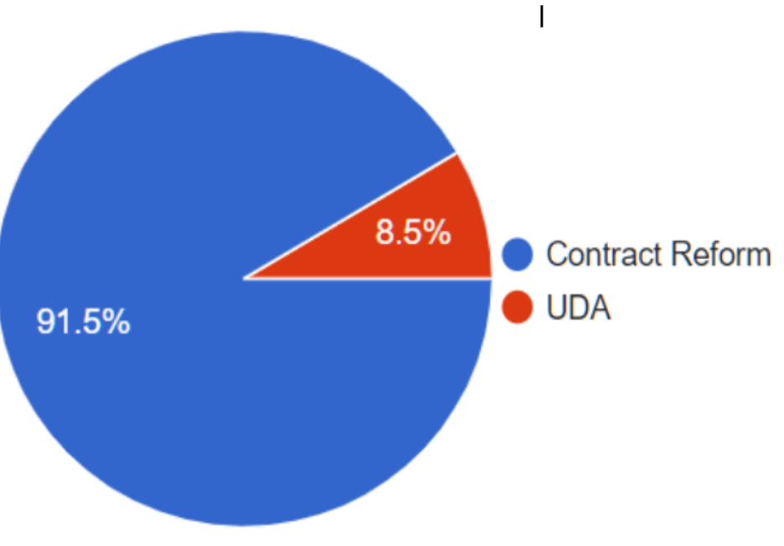
GDS Practice Contract Type
Contract Reform 43 of 53
UDA 4 of 7

Slide 6
Working Dentists
Number in GDS Practices 156
Number of Whole Sessions Worked 973.5
WTE doing General Dental Work 62.4

Slide 7
Working Dentists
Number in 47 GDS Practices 156
WTE doing NHS Work 40.6
WTE doing Private Work 21.8
WTE doing General Dental Work 62.4

Slide 8
Foundation Dentists Last 5 Years
Number of GDS Training Practices 16
Number of FDs Trained 70
Number of FDs Remained at Practice then left 4 0.06%
Number of FDs Remained at Practice 9 0.13%

Slide 9
Foundation Dentists Last 5 Years 6th October 2022
Number of GDS Training Practices 16
Number of FDs Trained 70
Number of FDs still in Wales 38 54%
Number of FDs stayed then left Wales 11 16%

Slide 10
Foundation Dentists Cost to WG of Training 1 FD in 2021/2022
Training Grant £11,424
FD Salary £33,372
Service Cost £67,680
Reimbursement NIC £3,395
Total Cost £115,871

Slide 11
Foundation Dentists At 2021/2022 Costs, Loss to WG over 5 Years
Total Cost of Training 70 FDs £8,110,970
Number FDs who have left Wales 32
Total Cost of Training 32 FDs £3,707,872
Total Cost (Loss) to WG £3,707,872

Slide 12
Dental Nurses 6th October 2022
Number in 50 SBUHB Practices 310
Number of Whole Sessions Worked 1751
WTE Working 175.1

Slide 13
Dental Nurses 6th October 2022
Number in SBUHB Practices 310
Number of Trainee Dental Nurses 85
WTE Working 175.1

Slide 14
Dental Nurses 6th October 2022
Number in SBUHB Practices 310
Number Trained to Perform Extra Duties 99 32%
Practices with Current Vacancies for DNs 19 38%
Number of Unfilled Vacancies 22

